Slide 1

Capstone #2
World Happiness
Presented by: Paola Ignatova
05/07/2021

Slide 2
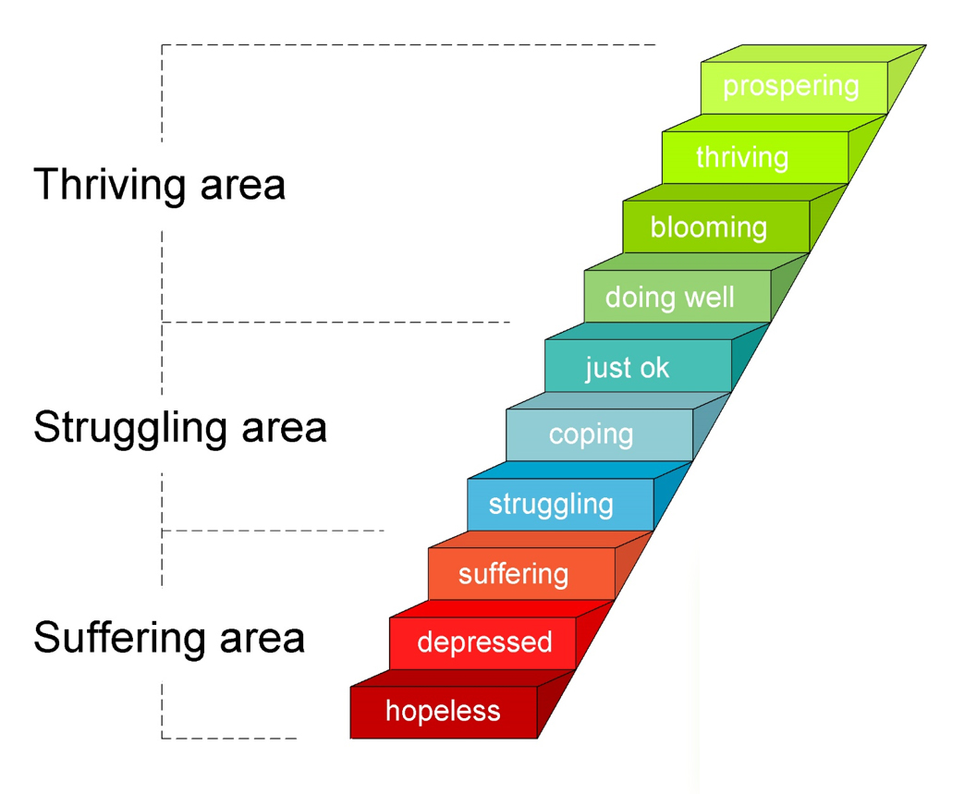
Overview
World Happiness Report and the Life Ladder
Research in world happiness is a relatively new endeavor.
The first World Happiness Report was published in 2012 as a foundational text for the UN High Level Meeting: Defining a New Economic Paradigm, drawing international attention.
It is based on the Gallup World Poll – a set of nationally representative surveys undertaken in more than 160 countries.
It uses the Cantril Ladder method. Respondents are asked to think of a ladder. The top of the ladder or 10 represents the best possible life, and the bottom of the ladder or 0 represents the worst possible life.
Happiness research became popular in the late 70s and early 80s, and saw real popularity in the 2000s.

Slide 3
Data Sources
World Happiness Report Dataset – includes data from 2010 to 2020. Along with Life Ladder Happiness Score, along with 6 main factors: log GDP per capita, Healthy Life Expectancy, Social Support, Freedom to make choices, Generosity, Corruption Perception.
Pew Research Center – provides surveys on global attitudes and trends and detail information on distributions of answers on the Cantril Ladder.
The World Bank – World Development Indexes like GDP, Gini index, Human capital index, education, population, healthcare, employment.
World Values Survey – collections of national surveys covering almost 100 countries that show cross country data on self reported life satisfaction.

Slide 4
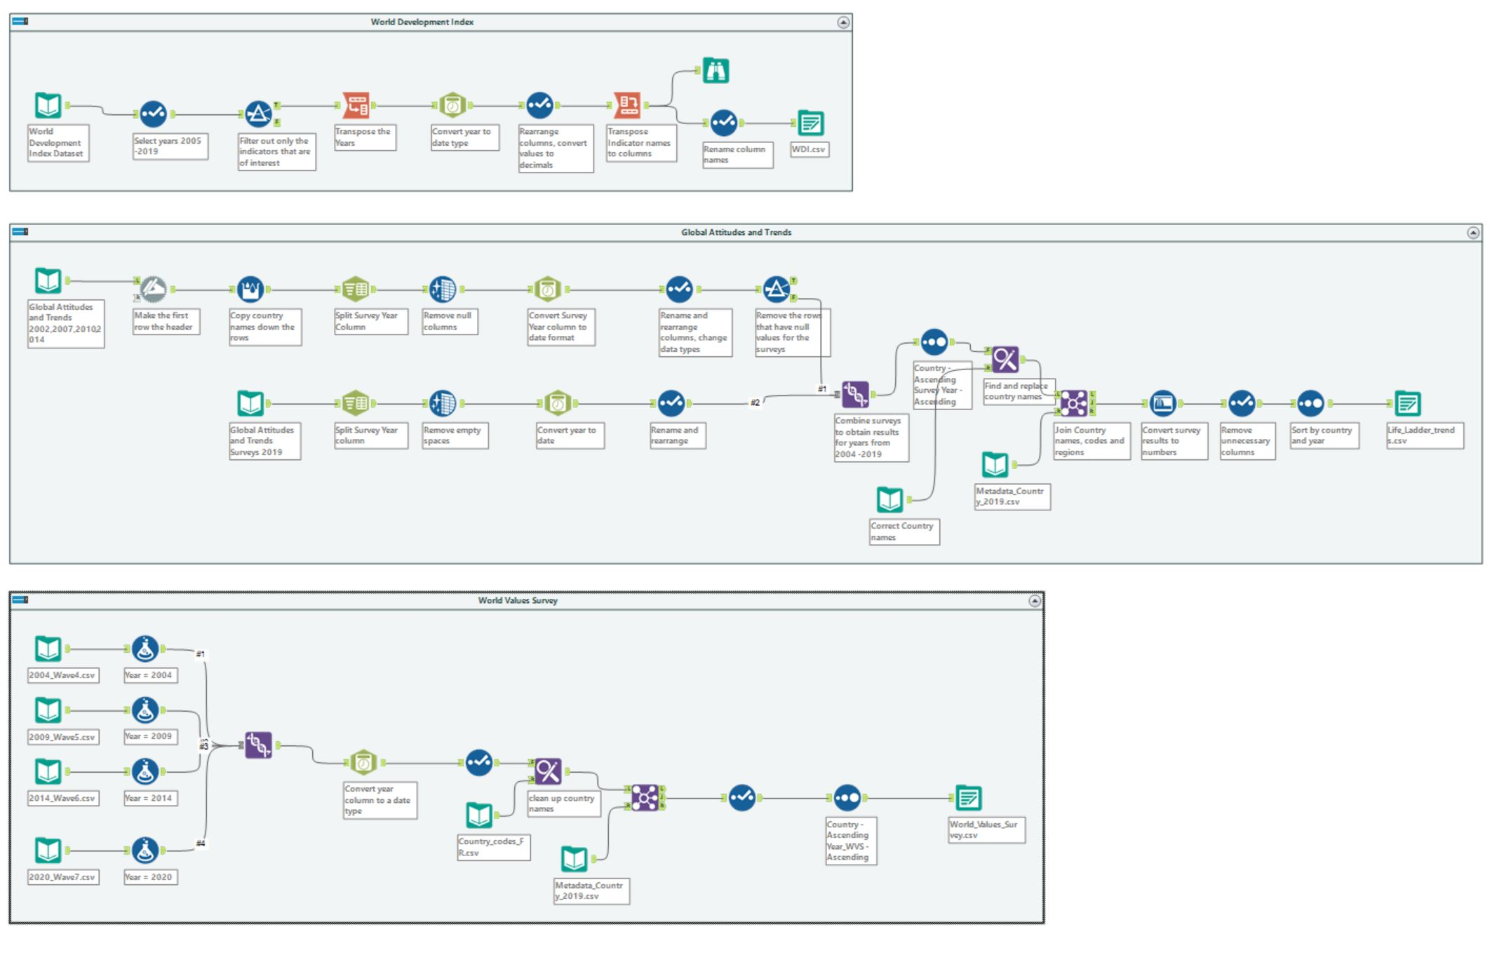
Alteryx – data prep made simple
GI based - no coding knowledge required
Intuitive tools for a variety of data clean up tasks
Organization workflow with sequential steps
Comments and containers to facilitate collaboration across team members

Slide 5
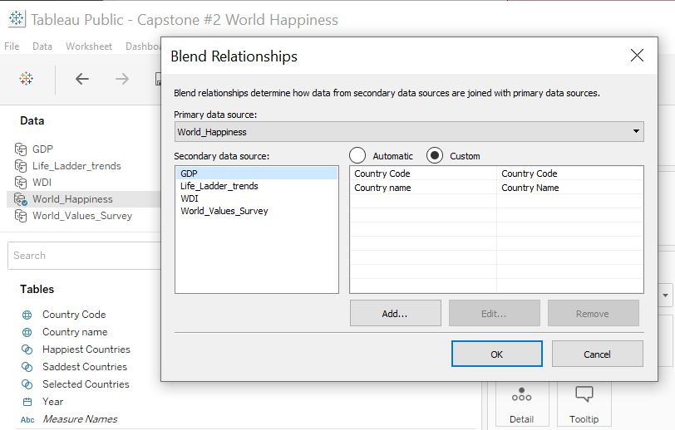
Tableau - transforming raw data into valuable insights
Remarkable capabilities to create quick and interactive visualizations
Speed and access to live data connections
Ease in handling large datasets
Integrates well with scripting languages like Python

Slide 6

Questions Raised
Happiness is hard to measure and can be very subjective.
What countries rank the highest in life satisfaction? What countries rank the lowest?
How did countries’ rankings change over time? How happy are people today? Are they happier than in the past?
How do different factors contribute to the overall happiness score?
How satisfies are people with their lives in different societies?
How does income inequality affect happiness?

Slide 7
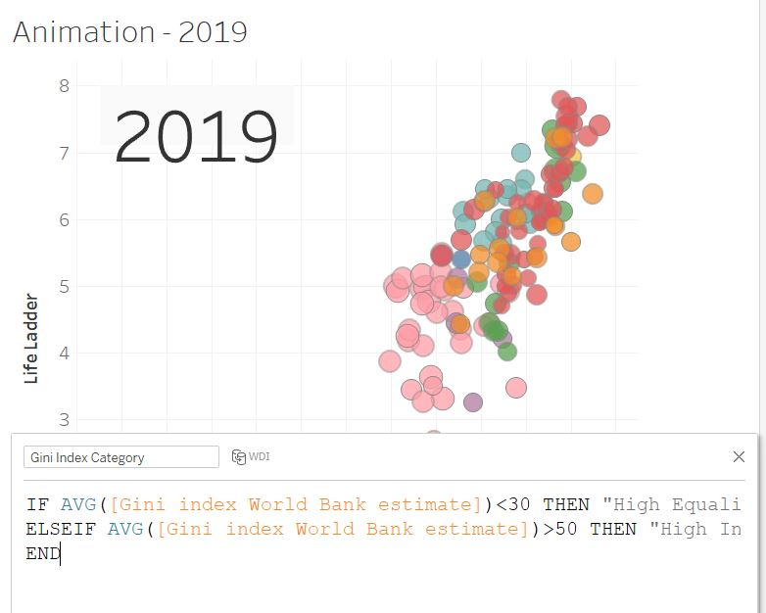
Advanced Tableau Techniques Used
Tableau animation.
Logical functions in calculations.

Slide 8
Thank you!

